Slide 1
CHAOS Report on Software Projects
Large study of software projects by Stanish Group, annually since 1990s.
How successful are software projects?
31% of projects were cancelled
52.7% of projects are over-budget
Only 61% of promised features actually delivered
Less than 50% of promised features delivered in ¼ of projects

Slide 2
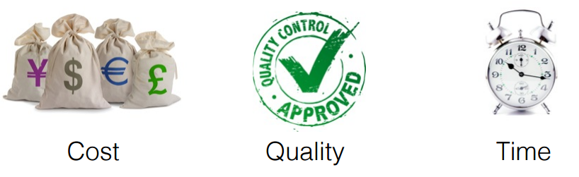
The Stanish Study
Survey 8,380 software projects from 365 respondants
Definition of software project outcome:
Success: completed on-time, on-budget, with all features as specified
Challenged: completed late, over budget, or fewer features than specified
Failed: project cancelled or never completed. ("impaired")

Slide 3
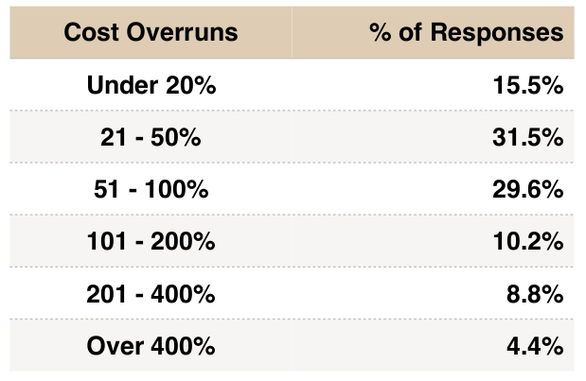
Cost Overrun

Slide 4
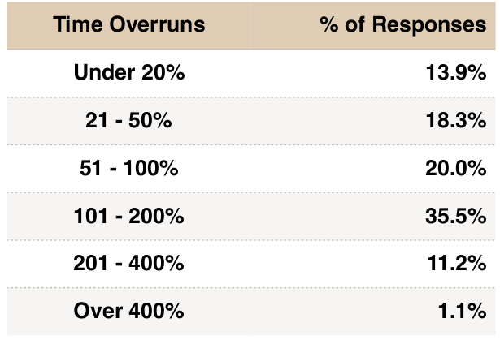
Time Overrun (Late)

Slide 5
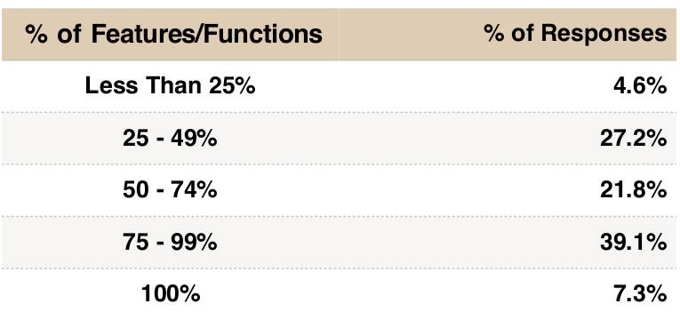
Incomplete Features
What % of the specified features were actually delivered?

Slide 6
What's the Current Status?
In the 2014 Stanish report...
"Currently, the 365 companies have a combined 3,682 applications under development. Only 431 or 12% of these projects are on-time and on-budget."

Slide 7
QUIZ
What % of software projects "failed"?
What % of large software projects "failed"?

Slide 8
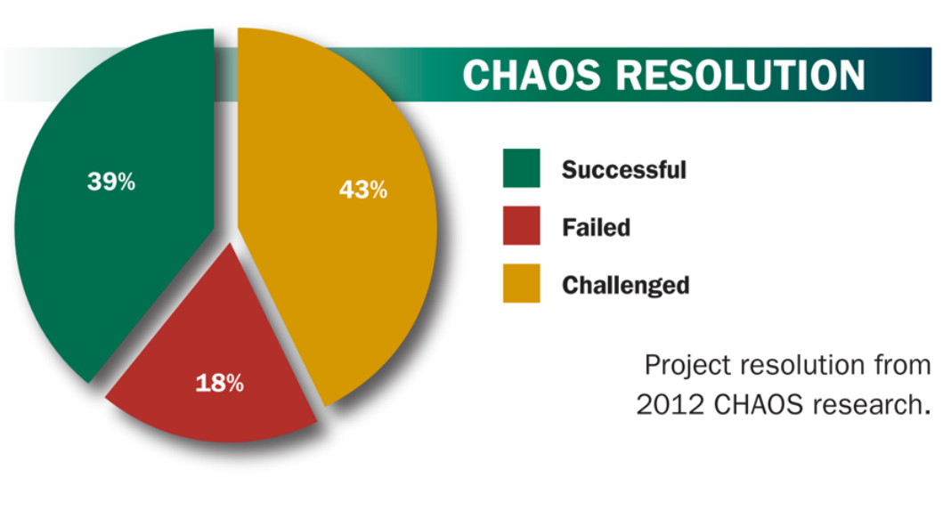
Project Failure Rates (2012)

Slide 9
Failures and Cause of Failures
Please read the slides "Reasons for project failures" by Andrew Short.
Then come back here. :-)

Slide 10
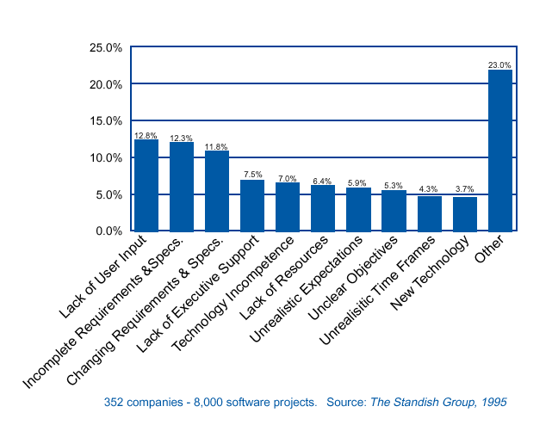
Why Software Projects Fail (1995)
- Average overrun: 89.9% on cost, 121% on schedule, with 61% of content

Slide 11
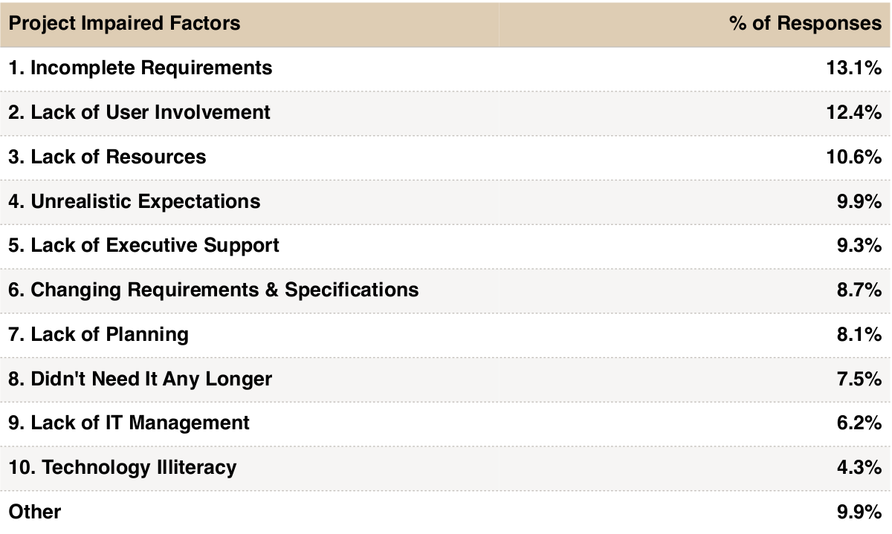
Why Projects Succeed or Fail (2014)
Based on survey of IT executive managers.

Slide 12
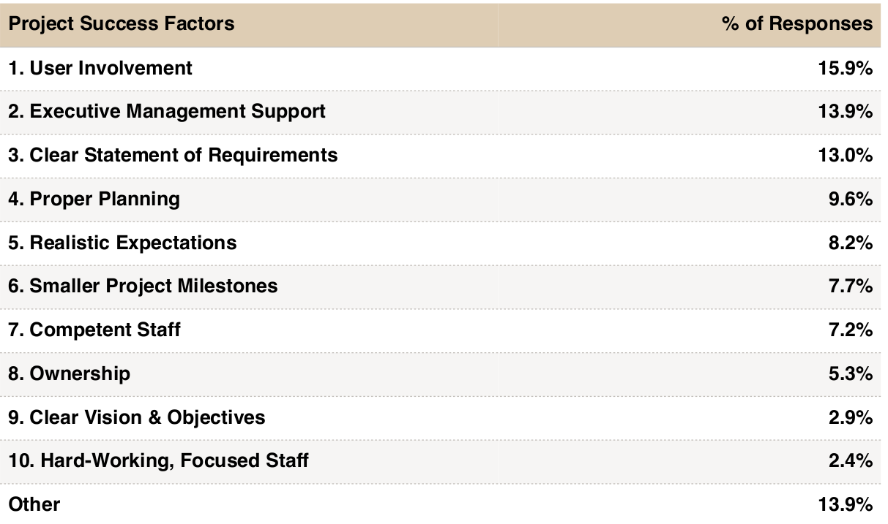

Slide 13
Criticism and Counterpoint
Problems with Stanish Survey:
may not be a representative sample
relies on self-reported data, esp. for causes of success/failure
Counterpoint:
Scott Amber, 2013 Project Success Rate Survey Results
http://www.ambysoft.com/surveys/success2013.html
and article "The Non-existent Software Crisis"
http://www.drdobbs.com/architecture-and-design/the-non-existent-software-crisis-debunki/240165910

Slide 14
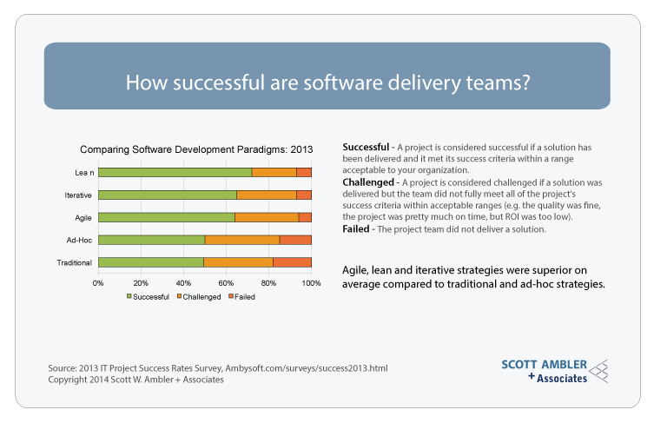

Slide 15
Examples of Failed Projects
British NHS IT System:
Largest healthcare IT system in world
Designed to reform & unify collection and use of NHS data
14 Billion Euros spent (over budget)
10 years, but overall not usable.
Denver Airport baggage handling system
Mars Climate Orbiter (1999) - error due to insufficient testing

Slide 16
Examples of Successful Projects
Voyager space craft (launched 1972, still working)
New Horizon (2005 - present)

